Slide 1
INTO THE DEEP
By
Archa Sekhar
Sidharth D

Slide 2
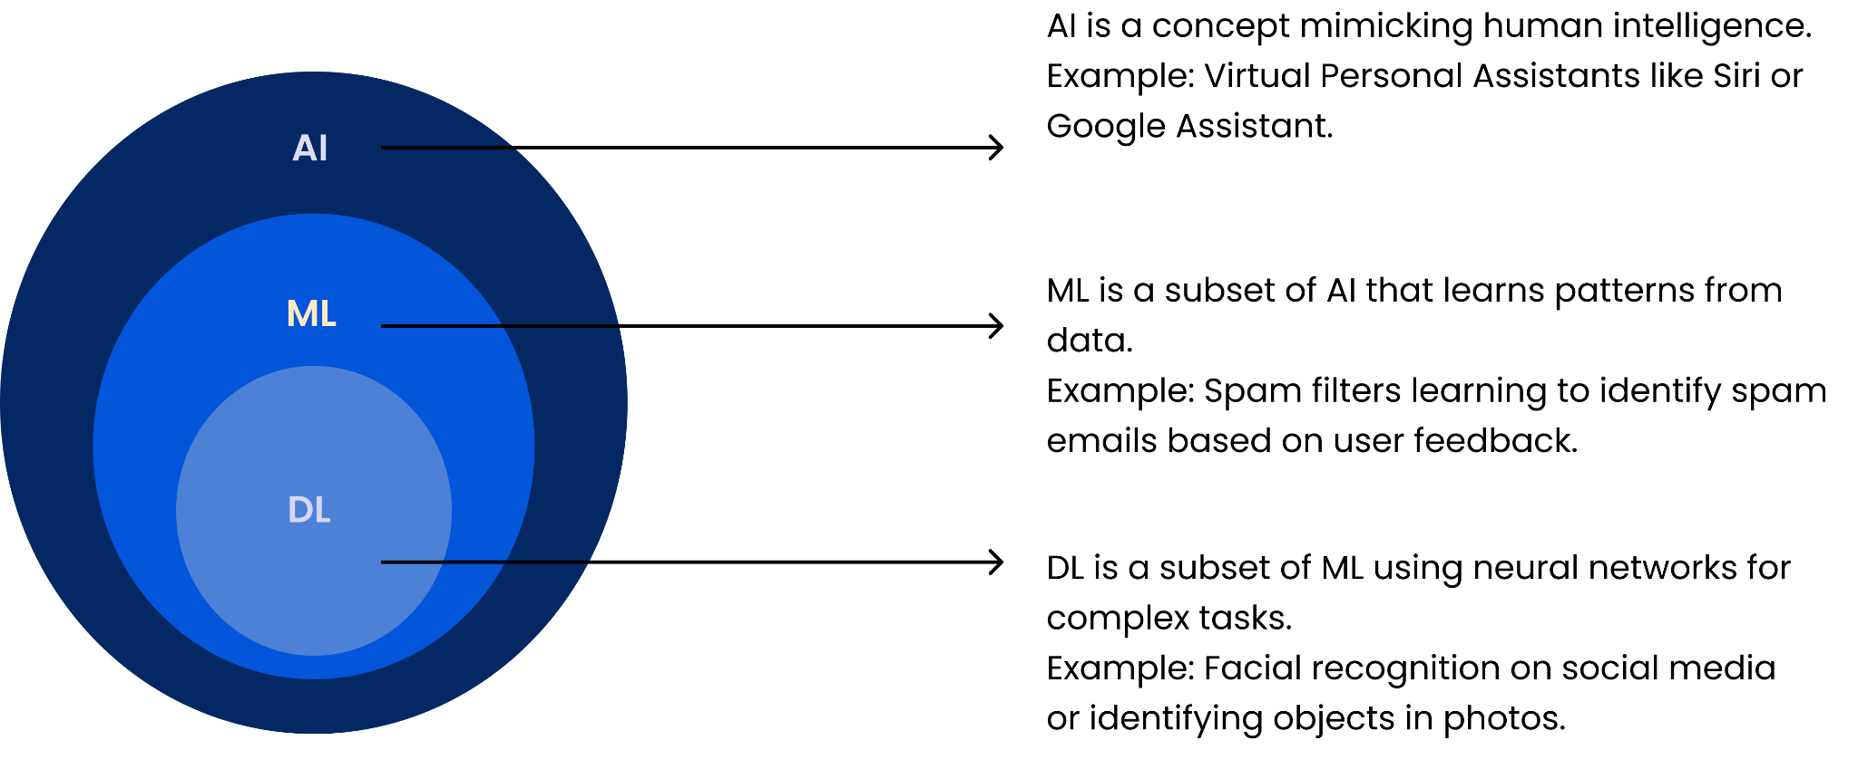
AI vs ML vs DL

Slide 3
Different types of Machine Learning
1. Supervised Learning:
In supervised learning, the algorithm is trained on a labeled dataset, where the input data is paired with corresponding output labels.
Example: Predicting house prices based on features like size, location, and number of bedrooms, given historical data where prices are already known.
2. Unsupervised Learning:
Unsupervised learning deals with unlabeled data. The algorithm tries to find patterns or structure in the data without explicit output labels.
Example: Clustering similar customer profiles based on their purchasing behavior without knowing in advance which group they belong to.

Slide 4
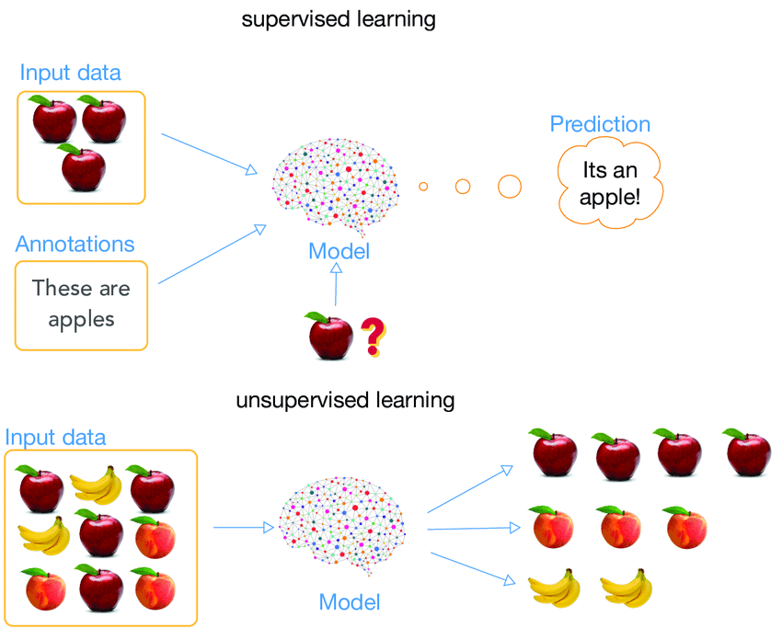

Slide 5
3. Reinforcement Learning:
Reinforcement learning involves an agent learning to make decisions by interacting with an environment. The agent receives feedback in the form of rewards or penalties.
Example: Training a computer program to play a game. The program learns by taking actions, receiving rewards (points), and adjusting its strategy to maximize cumulative rewards.
4. Semi-Supervised Learning:
Semi-supervised learning is a mix of supervised and unsupervised learning. The model is trained on a dataset that contains both labeled and unlabeled data.
Example: Classifying emails as spam or not spam with a dataset where only a portion of the emails are labeled.

Slide 6
What is Deep Learning ?
Deep Learning is a subset of machine learning that employs artificial neural networks with multiple layers to model and solve complex problems.
It excels at automatically learning intricate patterns from large datasets.
Deep Learning has proven successful in various fields, including image recognition, natural language processing, speech recognition, and recommendation systems.

Slide 7
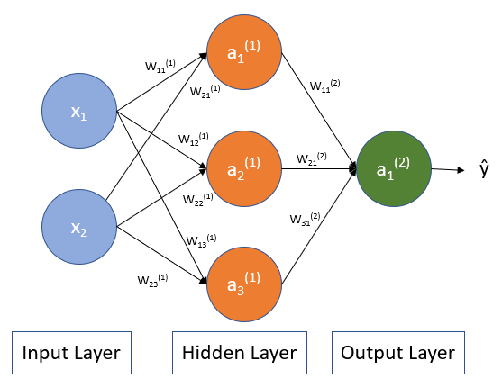
Neural Network
A computational model inspired by the structure and function of the human brain.
The basic building block of a neural network is the artificial neuron, or node.
These nodes are organized into layers, including an input layer, one or more hidden layers, and an output layer.
Each connection between nodes has an associated weight, and the network learns by adjusting these weights during a training process.

Slide 8
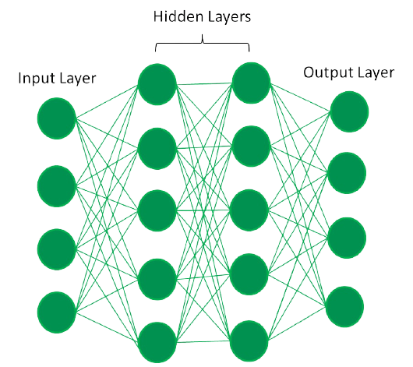
Input Layer: Receives input data, which could be features from a dataset.
Hidden Layers: Intermediate layers where the network processes and learns representations from the input data.
Output Layer: Produces the final output or prediction based on the processed information from the hidden layers.

Slide 9
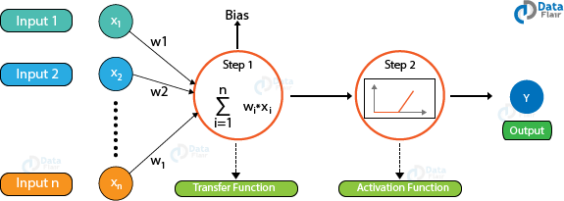

Slide 10
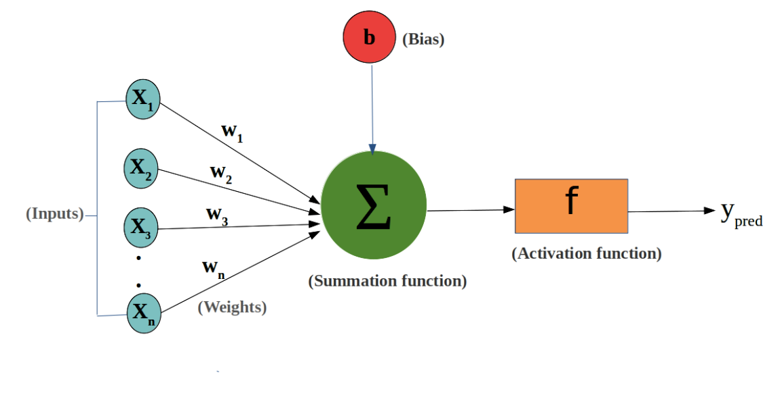
Bias
Bias can be defined as the constant which is added to the product of features and weights. It is used to offset the result. It helps the models to shift the activation function towards the positive or negative side.

Slide 11
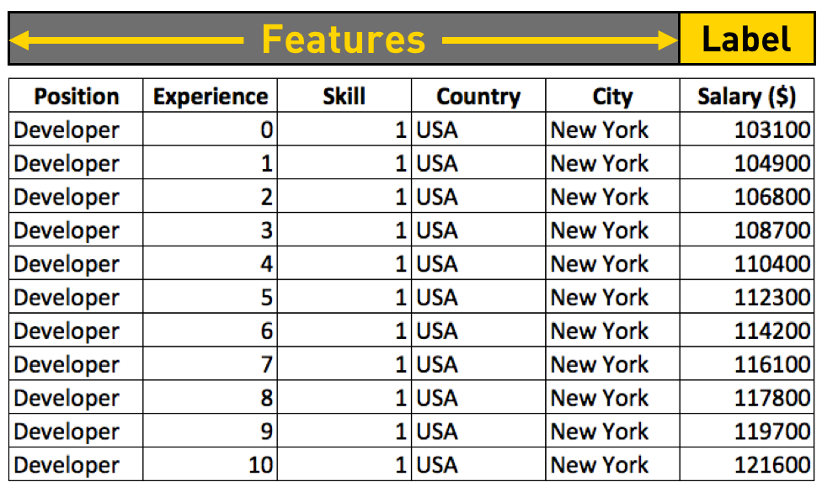

Slide 12
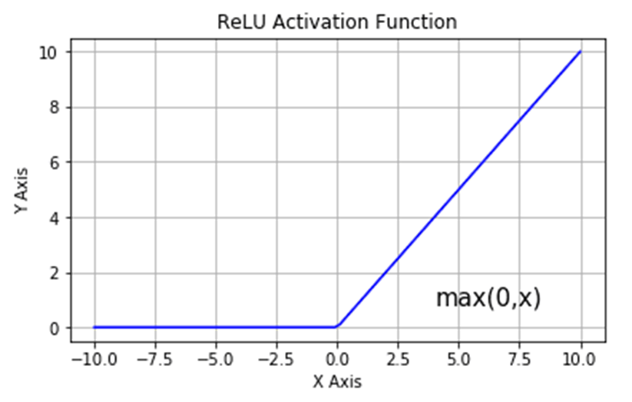
Activation Function
An Activation Function decides whether a neuron should be activated or not. This means that it will decide whether the neuron's input to the network is important or not in the process of prediction using simpler mathematical operations.

Slide 13
Backpropagation
Loss Function
Backpropagation is a supervised learning algorithm for training neural networks. It involves a forward pass to compute the output and an error, followed by a backward pass to calculate the gradient of the error with respect to the weights.
It measures the difference between the predicted output of a model and the actual target values for a given set of input data. The goal during training is to minimize this loss function, guiding the model to make more accurate predictions.

Slide 14
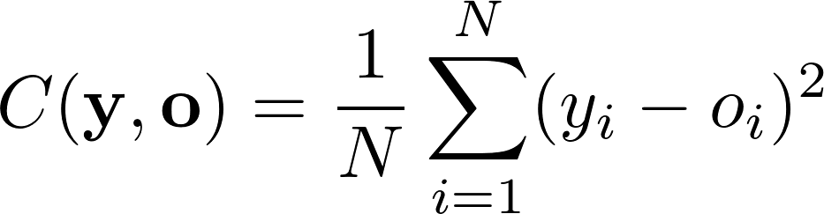
Gradient Descent in Artificial Neural Networks
Gradient Descent is an optimization algorithm used during the training phase of an ANN.
Its purpose is to minimize the loss function.
This is done by iteratively adjusting the weights of the network in the opposite direction of the gradient, thereby finding the optimal set of weights that minimizes the cost function.
An example of cost function:
Mean Squared Error

Slide 15
Overfitting:
Overfitting is a common problem in machine learning where a model learns the training data too well, capturing noise or random fluctuations in the data instead of the underlying patterns. As a result, the model performs well on the training set but fails to generalize to new, unseen data. Overfit models are often too complex and fit the training data too closely, making them less effective in making accurate predictions on new data.
Regularization:
Regularization is a technique used to prevent overfitting by adding a penalty term to the model's loss function. The penalty discourages the model from fitting the training data too closely and encourages it to generalize better to new, unseen data. Regularization techniques aim to find a balance between fitting the training data well and avoiding excessive complexity.

Slide 16

Underfitting:
Underfitting happens when a model is too simplistic to capture underlying patterns in the training data, leading to poor performance on both the training set and new data. It's associated with insufficient model complexity, lack of training data, or inadequate features.

Slide 17
CNN
CNN stands for Convolutional Neural Network, which is a specialized type of neural network designed for processing and analyzing structured grid data, particularly images and videos. CNNs have been highly successful in various computer vision tasks, such as image recognition, object detection, and image classification.

Slide 18

1 | 0 | 1
0 | 1 | 0
1 | 0 | 1
Filter

Slide 19


Slide 20
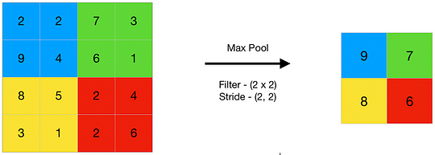
Pooling Layer
A pooling layer in a neural network is like a summarizer.The pooling layer helps you do that by taking the most important information and creating a condensed version.

Slide 21
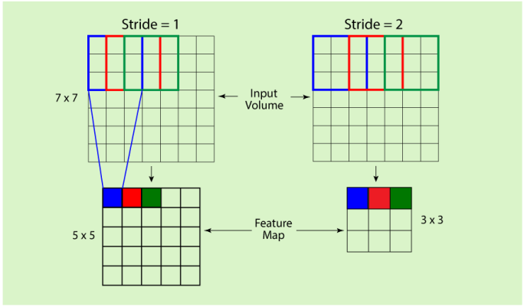
Stride refers to the number of pixels by which we move the filter across the input image.

Slide 22
Key features of Convolutional Neural Networks (CNNs) include:
Convolutional Layers: CNNs use convolutional layers to automatically learn spatial hierarchies of features from input images. These layers apply convolutional operations, involving filters or kernels, to detect patterns and features like edges, textures, and shapes.
Pooling (Subsampling) Layers: Pooling layers are used to downsample the spatial dimensions of the data while retaining important features. Max pooling and average pooling are common pooling techniques applied to the output of convolutional layers.
Fully Connected Layers: After the convolutional and pooling layers, CNNs often include fully connected layers to make predictions based on the learned features. These layers connect every neuron to every neuron in the previous and subsequent layers, allowing the network to capture complex relationships.
Activation Functions: Activation functions, such as ReLU (Rectified Linear Unit), are used within CNNs to introduce non-linearity and enable the network to learn and represent complex patterns in the data.

Slide 23
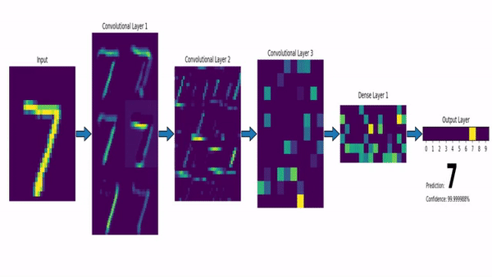
Feature maps in CNN

Slide 24
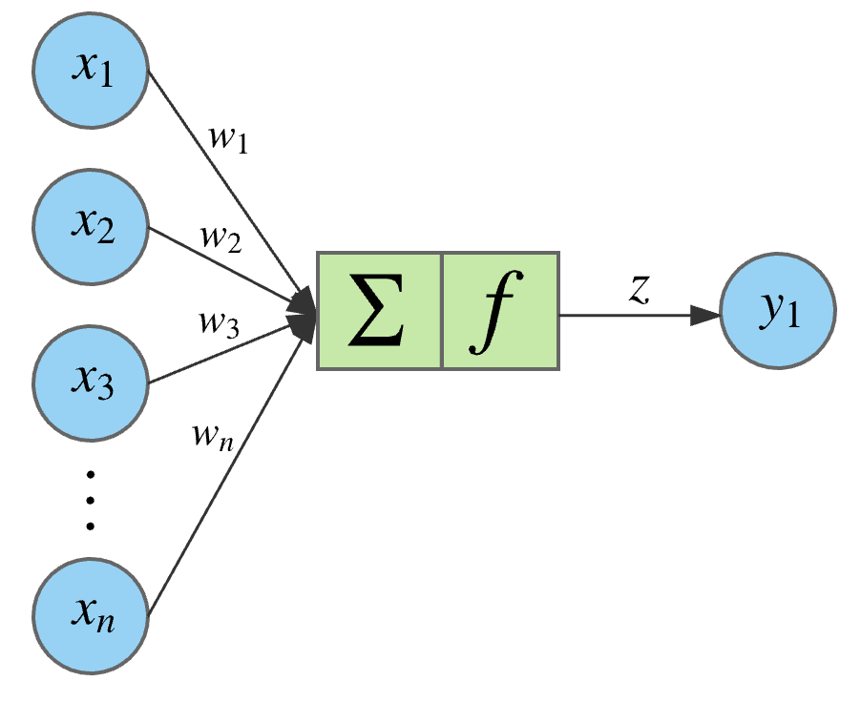
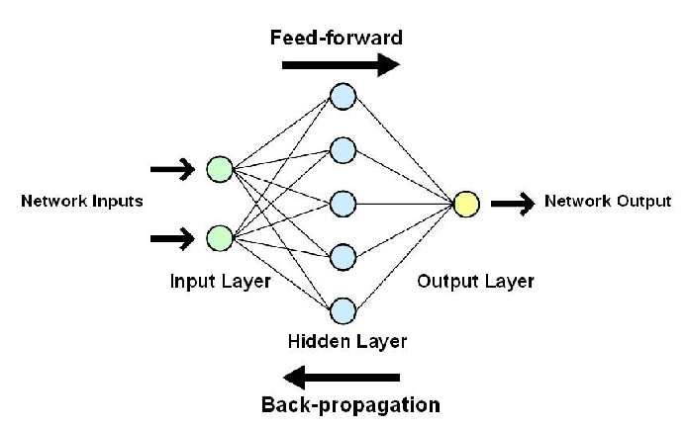
Learning Process:
Training: Show the network examples (like pictures of cats and dogs).
Adjustment: It learns by adjusting connections to better predict the correct answers.
Prediction: Now, it can predict if a new picture is a cat or a dog!

Slide 25
